Slide 1
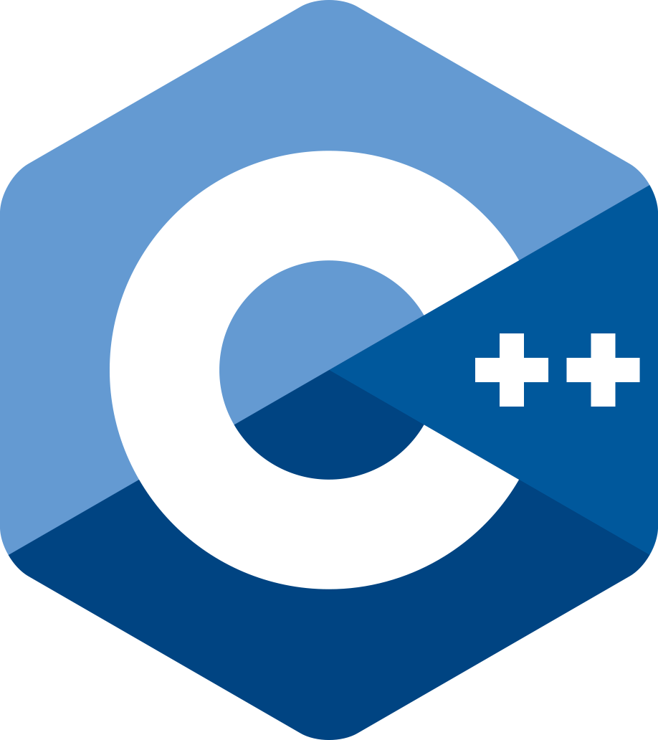

Modern C++ Course
Gammasoft

Slide 2

Who am I ?
Gammasoft
Gammasoft aims to make c++ fun again.
About
Gammasoft is the nickname of Yves Fiumefreddo.
More than thirty years of passion for high technology especially in development (c++, c#, objective-c, ...).
Object-oriented programming is more than a mindset.
more info see my GitHub : https://github.com/gammasoft71
Gammasoft
Modern C++ Course

Slide 3
Outline
Introduction
Language Basics
Object Oriented Programming (OOP)
Core Modern C++
Modern C++ Expert
Advanced Programming
Gammasoft
Modern C++ Course

Slide 4
Outline
Introduction
Language Basics
Object Oriented Programming (OOP)
Core Modern C++
Modern C++ Expert
Advanced Programming
Gammasoft
Modern C++ Course

Slide 5
Outline
Introduction
Language Basics
Object Oriented Programming (OOP)
Core Modern C++
Modern C++ Expert
Advanced Programming
Gammasoft
Modern C++ Course

Slide 6
Outline
Introduction
Language Basics
Object Oriented Programming (OOP)
Core Modern C++
Modern C++ Expert
Advanced Programming
Gammasoft
Modern C++ Course

Slide 7
Outline
Introduction
Language Basics
Object Oriented Programming (OOP)
Core Modern C++
Modern C++ Expert
Advanced Programming
Gammasoft
Modern C++ Course

Slide 8
Outline
Introduction
Language Basics
Object Oriented Programming (OOP)
Core Modern C++
Modern C++ Expert
Advanced Programming
Gammasoft
Modern C++ Course

Slide 9
Outline
Introduction
Language Basics
Object Oriented Programming (OOP)
Core Modern C++
Modern C++ Expert
Advanced Programming
Gammasoft
Modern C++ Course

Slide 10
Outline
Introduction
Language Basics
Object Oriented Programming (OOP)
Core Modern C++
Modern C++ Expert
Advanced Programming
Gammasoft
Modern C++ Course

Slide 11
End
Gammasoft
Modern C++ Course

